Slide 1
Assuring ML Applications
and AI-Enabled Engineering
DO-178C / DO-330 · MOD JSP 936 · MAA · EASA · System Safety
Oliver Haythornthwaite · 16 August 2026
Thesis: AI can support engineering and ML can be fielded only where authority, evidence, independence and configuration control remain explicit.
1

Slide 2
Current state of certification
Existing assurance frameworks remain the baseline; AI-specific approval material is still evolving.
DO-178C baseline
System safety baseline
AI/ML guidance
Emerging Material
Mature lifecycle evidence for airborne software: requirements, verification, coverage, independence, CM and QA.
Hazard assessment establishes safety objectives and assurance levels; evidence closes the integrated safety argument.
EASA, JSP 936, MAA guidance recognises additional needs: learning assurance, explainability, data, drift and ethical implementation.
EASA Proposed Issue 3 supplies actionable objectives but explicitly, is not published guidance.
Implication: the field is not starting from zero. Instead adapting established assurance discipline to learned behaviour.
External context: EASA AI Concept Paper Issue 2 (2024); FAA AI Safety Assurance Roadmap (2024); UK CAA AI principles/strategy; MAA/RN/2025/04.
Ethical Assurance & Certification of MLA under DO-178C
2

Slide 3
Policy ecosystem
Linking assurance claims to defence, civil aviation and software assurance sources.
MOD dependable AI / safety / HFI
JSP 936 + JSP 912/815/945 Governance, ethics, human factors and safety accountability
DO-178C + DO-330/331/332
Software lifecycle, tools, model-based development and OO techniques
System safety & certification basis
Hazards, performance objectives, derived requirements and integrated safety argument
MAA RN / EASA Proposed Issue 3
Current MAA position and emerging EASA objectives.
This stack aims towards a safety-case approach, not a generic model-accuracy argument.
Based on the document policy-context table and policy-traced arguments.
Ethical Assurance & Certification of MLA under DO-178C
5

Slide 4
The certification gap
DO-178C evidence remains necessary - but is insufficient for learned behaviour.
Established software assurance
• Requirements-based tests
• Structural (MC/DC) coverage
• Tool qualification
• CM / QA / independence
MLA specific assurance
• Data provenance & representativeness
• ODD coverage & distribution shift
• Robustness & uncertainty
• Explainability, monitoring & security
Assurance bridge
MLA must not be treated as a special exception. Existing principles continue to apply. Additional evidence must address data, learned behaviour, uncertainty and the integrated safety response.
Document abstract and preface: DO-178C is a baseline; additional evidence is required for model behaviour, data and operational drift.
Ethical Assurance & Certification of MLA under DO-178C
3

Slide 5
Purpose, scope and boundary conditions
Definition of the scope of applicability.
In scope
Out of scope / not approved by this argument
Supervised, offline-trained ML models.
Classifiers, perception, decision support, anomaly detection and optimisation.
Airborne and operationally influencing systems including ground support, mission planning, maintenance and training.
Adaptive in-service learning
Autonomous lethal decision-making
Uncontrolled online model updates
Opaque third-party foundation model dependency
Any deployment without agreed certification and safety basis
Default, safe stance: freeze the model, configuration control the datasets/tools/parameters, bound the output within a deterministic failsafe architecture, and treat retraining as a formal change.
Ethical Assurance & Certification of MLA under DO-178C
4

Slide 6
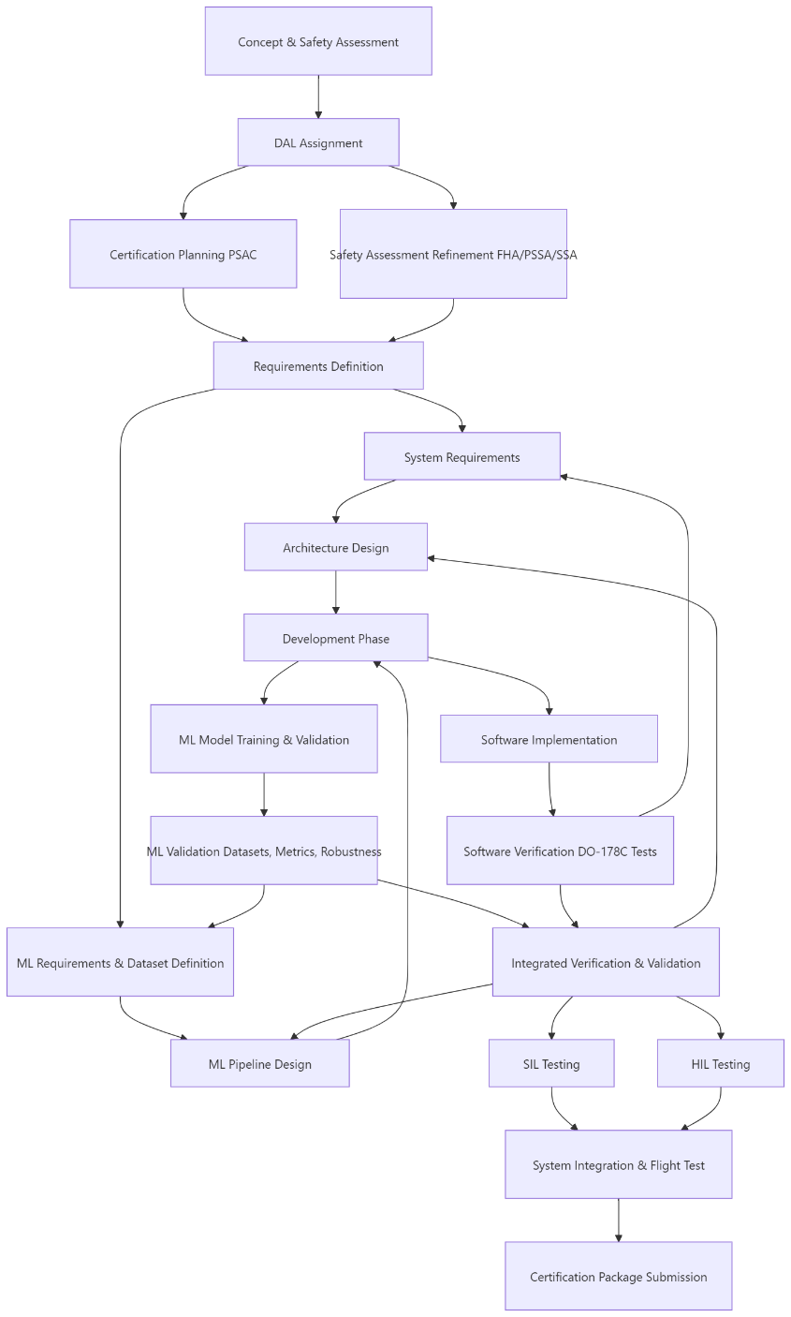
High-level certification flow
Treat the flow as iterative, not as a simple waterfall schedule.
The initial concepting and provision of a safety assessment define the certification basis and DAL early.
ML requirements and dataset definition must sit alongside system requirements.
Model training, software implementation and integrated verification converge before SIL, HIL and flight test.
Authority engagement, issue closure and evidence funding are programme dependencies, not late-stage admin.
To support project level confidence:
Each box is an evidence decision point.
The question is not “did the model perform?” but “does the evidence still apply to the configured system?”
Software implementation progresses alongside ML training and validation allowing for parallelised, specialist team support.
Unit / SW/SW / HW/SW and Acceptance testing remains the point at which functional behaviour is confirmed across levels of integration maturity.
Document Figure 1, p.11.
Ethical Assurance & Certification of MLA under DO-178C
6

Slide 7
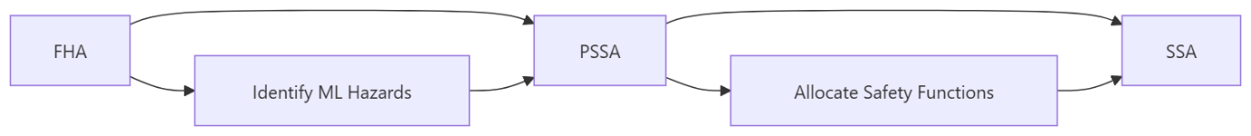
Safety assessment first
MLA hazards must be explicit before safety functions are allocated.
The application of a suitability matrix provides a concrete decision screen.
High-criticality, opaque, unbounded or no-fallback cases should be de-scoped, downgraded or isolated.
The safety architecture (not model confidence alone) determines whether MLA can be credited.
Factor
Low concern
Medium concern
High concern
Function criticality
Advisory
Influences operator
Affects control
Model authority
Recommendation
Bounded decision
Autonomous action
Need for action: projects need a repeatable “go / constrain / stop” mechanism before AI becomes embedded in the design.
Successfully performing this assessment, establishing a concern threshold, and applying this consistently, will avoid pitfalls around the individual consideration of any factor.
Explainability
Clear rationale
Partial rationale
Opaque output
ODD containment
Well defined
Partially monitored
Poorly bounded
Fallback
Deterministic
Verified human
No fallback
Document Figure 2, p.12 and Table 2, p.13.
Ethical Assurance & Certification of MLA under DO-178C
7

Slide 8
Architecture principle
Make the system boundary deterministic even when the model is statistical.
Guard: Confidence threshold met.
Constrained
inputs
MLA model
(frozen baseline)
Runtime
monitor
Safe output
interface
Guard: Output validated successfully.
Fallback / rejection / degraded mode / human review stage.
Isolate and partition MLA components like other safety-related items.
Expose safely interpreted information: enumerated states, mapped classes or constrained confidence bands.
Verify rejection logic, fallback paths and monitor behaviour as part of the safety architecture.
Range limits alone do not demonstrate contextual validity or safe recovery.
Ethical Assurance & Certification of MLA under DO-178C
8

Slide 9
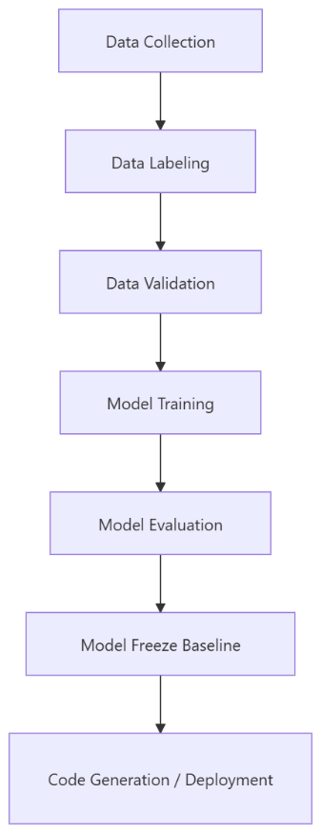
MLDevOps for certification
A controlled assurance pipeline, not a rapid model-improvement loop.
ML
Datasets, provenance, ODD coverage, bias, training configuration, robustness and known failure modes
DEV
Interfaces, monitors, deterministic safety controls, fallback, integration and portability
OPS
Release baselines, evidence packs, drift monitoring, change control and continued approval
The pipeline must produce evidence as a reproducable output: datasets, tools, parameters, environment definitions and model baselines must be reconstructable.
Document model implementation and MLDevOps sections, pp.14–18.
Ethical Assurance & Certification of MLA under DO-178C
9

Slide 10
Specific recommendations: design
Design the MLA as a bounded system item, not a free-standing algorithm.
Modular item
Allocate explicit requirements, interfaces, input constraints and output meanings to the MLA component.
Monitor + fallback
Design runtime monitors, rejection logic, degraded modes and verified fallback paths from the outset.
Deterministic boundary
Expose only safely interpreted outputs: enumerated states, mapped classes or constrained confidence bands.
Suitability gate
If criticality, autonomy, opacity or ODD uncertainty is high, de-scope, downgrade or isolate the function.
Isolation & partitioning
Use loose coupling, partitioning and redundancy where the safety assessment requires it.
Design test for adoption: can the surrounding architecture keep the aircraft or aviation system safe when the model is wrong, uncertain, stale, unavailable or adversarially influenced?
Drawn from Architecture Design and suitability matrix recommendations, pp.13–14.
Ethical Assurance & Certification of MLA under DO-178C
10

Slide 11
Specific recommendations: implementation
Make repeatability and configuration control part of the model build.
Data and model build
Deployment and environment
Validated, configuration-controlled datasets
Documented provenance, ownership, licensing and suitability
Bias, imbalance, under-representation and over-representation analysis
Model architecture, hyperparameters, tooling and environment baselines
Repeatable training pipeline with reconstructable outputs
Demonstrate functional equivalence between development and target-equivalent environments
Analyse portability where GPUs, TPUs or high-memory embedded processors are used
Control preprocessing, post-processing, model files, thresholds and generated artefacts
Prevent technical debt from compromising verification or evidence traceability
Freeze model baselines before certification evidence is credited
Implementation recommendation: establish the MLDevOps/CAS pipeline before substantive model development, so evidence can be produced upfront or generated regressively rather than reconstructed after the fact.
Drawn from Model Implementation and MLDevOps process sections, pp.14–18.
Ethical Assurance & Certification of MLA under DO-178C
11

Slide 12
Specific recommendations: testing
Verify both model performance and safe integrated behaviour.
Unit
Preprocessing, feature extraction, input validation, post-processing, confidence handling, monitor logic, model loading, boundary values and malformed inputs.
SIL
Nominal scenarios, edge cases, degraded data, simulated sensor failures, out-of-distribution inputs and regression datasets.
HIL
Timing, memory, processing constraints, bus behaviour, sensor effects and target-equivalent hardware performance.
Flight
Real-world validation, HMI assessment, certification data collection, clear test boundaries, fallback procedures, independent monitoring and abort criteria.
Testing recommendation: demonstrate safe system response when the model is correct, incorrect, uncertain, unavailable, degraded or exposed to unexpected inputs.
Drawn from Verification of the Model and Integrated System and System Integration and Flight Testing sections, pp.18–23.
Ethical Assurance & Certification of MLA under DO-178C
12

Slide 13
AI changes the evidence—not the discipline
Traditional practices remain; learning introduces additional evidence.
Assurance area
Conventional software
ML-enabled system
Requirements
Mostly explicit behaviour
Behaviour partly learned from data; data and ODD requirements become first-class
Coverage
Structural coverage supports code assurance
Need dataset, scenario, ODD, edge-case and robustness coverage
Correctness
Can reason from requirements, design and code
Must demonstrate statistical behaviour, uncertainty and limits of generalisation
Change
Source/configuration changes dominate
Dataset, labels, hyperparameters, model weights, thresholds and tools also change behaviour
Operations
Post-release monitoring supports continued airworthiness
Drift and ODD excursions can invalidate certified assumptions without code changes
JSP 936 §§138–173 and §§205–208; EASA Proposed Issue 3.
Assuring ML Applications and AI-Enabled Engineering
16
Notes:
Traditional assurance principles remain, while data, learning and ODD evidence become first-class.
[Sources]
- https://assets.publishing.service.gov.uk/media/6735fc89f6920bfb5abc7b62/JSP936_Part1.pdf
- https://assets.publishing.service.gov.uk/media/68f0b97c1c9076042263ef2a/MAA_RN_2025_04.pdf
- https://www.easa.europa.eu/sites/default/files/dfu/easa_concept_paper_guidance_for_artificial_intelligence_applications_proposed_issue_03.pdf
[/Sources]
Internal context: s479832 - AutomatingSafetyCriticalEngineering.docx (background, findings and conclusions only).

Slide 14
Verification ladder
Progress from model behaviour to operationally representative system evidence.
Unit
SIL
HIL
Integration
Flight test
Supporting software, model load, boundary and malformed inputs
Nominal, edge, degraded, OOD and regression scenarios
Timing, resources, bus, sensor and target-equivalent hardware effects
Model plus monitors, fallback, override and safety response
Real-world validation with boundaries, abort criteria and independent monitoring
Unit, Simulation, SIL and HIL must discover basic model failure modes, reducing risk earlier in the product lifecycle so Integration/Flight test may validate assumptions and collect evidence under controlled conditions.
Ethical Assurance & Certification of MLA under DO-178C
14

Slide 15
Tool qualification expands for MLA
Tools may shape the evidence, not just the code.
Training frameworks
Model artefacts
Synthetic data
Evidence representativeness
Data preprocessing
Feature distributions
Model conversion
Deployable baseline
Labelling / annotation
Ground truth
Evidence systems
Traceability & compliance status
The need for greater tool qualification is driven by the possibility for new tools to mask defects or corrupt evidence, then generate deployable artefacts, changing model behaviour.
This reinforces the need for risk aware process and toolset selection, but there is little need to modify toolsets associated with traditional high integrity software production (SCADE), so long as a route to the integration of qualified MLA code is possible.
Ethical Assurance & Certification of MLA under DO-178C
15

Slide 16
Certification package
A coherent, reviewable evidence body linked to a configured release
Conventional artefacts
ML-specific additions
Release traceability
PSAC / certification plans
Requirements and design artefacts
Verification plans and results
CM, QA and tool evidence
Safety assessments and hazard logs
Dataset provenance and bias analysis
Training / validation / test definitions
Model architecture and hyperparameters
Robustness, uncertainty and explainability
ODD, monitor and fallback evidence
Which evidence applies to which model?
Which dataset and toolchain version?
Which deployment hardware?
Which monitor thresholds?
Which authority issues are closed?
The document positions the CAS as an active certification-management mechanism: incomplete, stale or non-representative evidence keeps the claim open.
Despite offering similar indications, products such as ANSYS Medini, may not suffice for the additional formats within the corpus of evidence, consideration of the additional evidence formats must inform the selection of such a tool.
Document certification package and gaining certification sections, pp.24 and 29–30.
Ethical Assurance & Certification of MLA under DO-178C
16

Slide 17
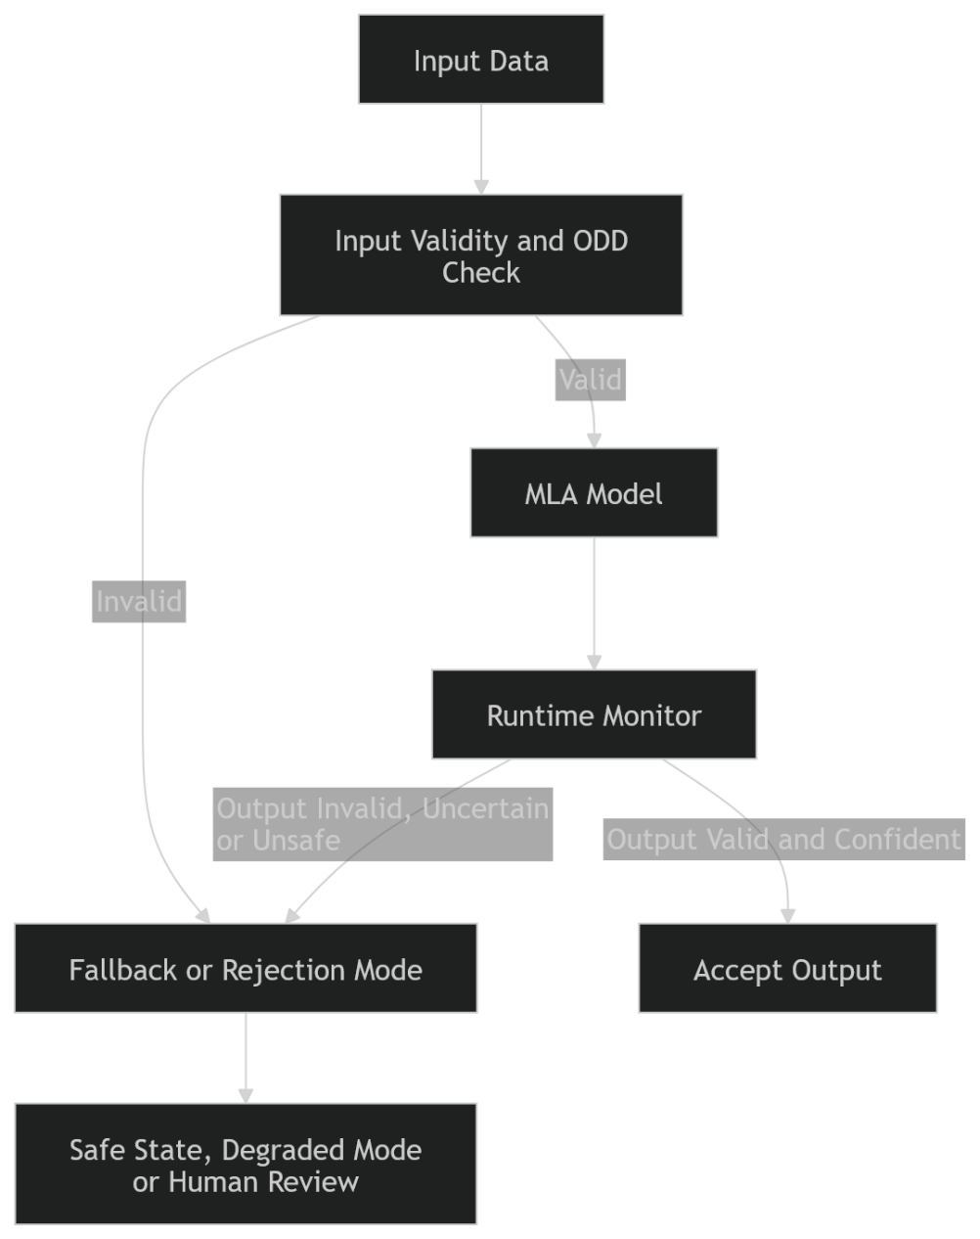
Operations and continued airworthiness
Certification is not the end of assurance activity.
Monitor ODD excursions, confidence, uncertainty, rejection rates, fallback events and degradation trends.
When assumptions diverge, restrict, withdraw, retrain under formal change control or re-certify.
Online learning is not permitted for safety-related functions unless a specific certification basis has been agreed.
Operational data may support future improvement, but deployed behaviour must not change without authorised release control.
Action required: build the operational feedback loop now, but keep behavioural change behind configuration control. Treating MLA like a modular artefact which can be switched out.
Document runtime monitoring, no online learning and continued airworthiness sections, pp.26–30.
Ethical Assurance & Certification of MLA under DO-178C
17

Slide 18
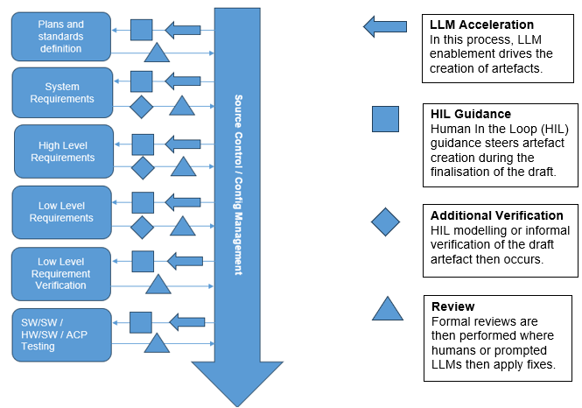
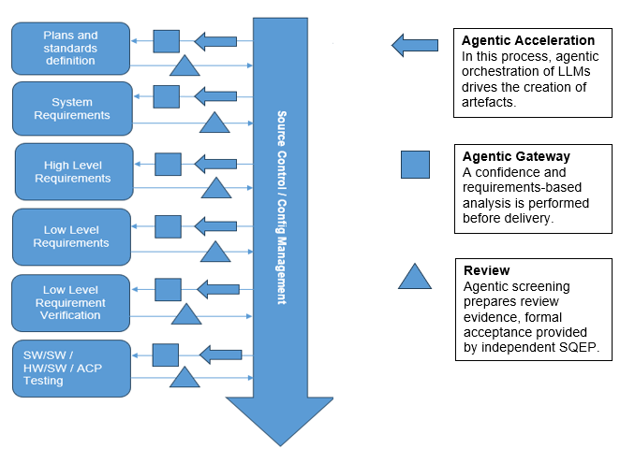
AI Enabled Development
Accelerate engineering work while preserving human authority, independent verification and controlled evidence.
Ethical Assurance & Certification of MLA under DO-178C
17

Slide 19
Do not conflate two assurance questions
AI used to engineer a system and AI deployed within it create different evidence obligations.
AI as a development aid
• Tool use and credit agreed in plans
• Generated output independently verified
• Project corpus, prompts and logs controlled
• Information boundary and licensing explicit
AI in the product or service
• Hazard assessment and system safety case
• Data, model and ODD requirements
• Learning assurance, robustness and monitoring
• Authority-specific approval route
Shared controls
Both require configuration, traceability, SQEP accountability, security and evidence. Neither inherits trust from model fluency.
Report context: AI-enabled engineering. Main deck: assurance of deployed ML.
Assuring ML Applications and AI-Enabled Engineering
7
Notes:
Report summary: development aids and deployed AI create related but distinct assurance questions.
[Sources]
- https://www.faa.gov/documentLibrary/media/Advisory_Circular/AC_20-115D.pdf
- https://assets.publishing.service.gov.uk/media/6735fc89f6920bfb5abc7b62/JSP936_Part1.pdf
- https://assets.publishing.service.gov.uk/media/68f0b97c1c9076042263ef2a/MAA_RN_2025_04.pdf
- https://www.easa.europa.eu/sites/default/files/dfu/easa_concept_paper_guidance_for_artificial_intelligence_applications_proposed_issue_03.pdf
- https://doi.org/10.6028/NIST.SP.800-218A
[/Sources]
Internal context: s479832 - AutomatingSafetyCriticalEngineering.docx (background, findings and conclusions only).

Slide 20
Incremental adoption is the defensible position
Increase automation only when benefit is measurable and assurance remains non-inferior.
Bounded pilot
Start with low-risk, reversible tasks; assume no certification credit for generated output.
Tool boundary
Sandbox access; least privilege; controlled interfaces to SCADE, Git and documents.
Controlled corpus
Use reviewed, issued and baselined material; retain source links, prompts and logs.
Advance or stop
Progress only if quality, traceability, security and schedule evidence justify added autonomy.
Human authority
Keep SQEP ownership, independent verification and explicit acceptance gates.
Agentic orchestration brings potential concurrency and a larger assurance change. If benefit does not exceed integration and review overhead, retain the safer process.
Report synthesis; supported by JSP 936, NIST SP 800-218A and NASA/TM-20250001849.
Assuring ML Applications and AI-Enabled Engineering
8
Notes:
Report conclusion: advance capability incrementally and retain the safer process unless added autonomy produces measurable benefit without assurance regression.
[Sources]
- https://assets.publishing.service.gov.uk/media/6735fc89f6920bfb5abc7b62/JSP936_Part1.pdf
- https://doi.org/10.6028/NIST.SP.800-218A
- https://ntrs.nasa.gov/api/citations/20250001849/downloads/NASA-TM-20250001849.pdf
[/Sources]
Internal context: s479832 - AutomatingSafetyCriticalEngineering.docx (background, findings and conclusions only).

Slide 21
Productivity evidence is context-dependent
Published results do not support a universal schedule-reduction factor.
Evidence
Context
Observed effect
Peng et al. (2023)
Standardised JavaScript task
55.8% faster completion
Cui et al. (2026)
4,867 developers; three companies
26.08% more completed tasks (SE 10.3%)
Becker et al. (2025)
Experienced maintainers; familiar repos
19% longer task time
Perry et al. (2023)
Security programming tasks
Less secure code with AI access
NASA (2025)
Assurance-argument literature review
Fitness for engineering practice remains unproven
Implication: measure active time, review, rework and defect escape separately.
Assuring ML Applications and AI-Enabled Engineering
6
Notes:
Report summary: published productivity effects vary sharply by task, codebase familiarity and outcome measure. The report is used here only for contextual findings and conclusions.
[Sources]
- https://arxiv.org/abs/2302.06590
- https://pubsonline.informs.org/doi/10.1287/mnsc.2025.00535
- https://metr.org/Early_2025_AI_Experienced_OS_Devs_Study-paper.pdf
- https://dl.acm.org/doi/10.1145/3576915.3623157
- https://ntrs.nasa.gov/api/citations/20250001849/downloads/NASA-TM-20250001849.pdf
[/Sources]
Internal context: s479832 - AutomatingSafetyCriticalEngineering.docx (background, findings and conclusions only).

Slide 22
LLM / Agentic acceleration differences
One compresses tasks; the other can compress elapsed time through controlled concurrency.
LLM-supported workflow
• Human initiates each step
• Model drafts or reviews one artefact at a time
• Engineer integrates and accepts output
• Primary gain: active-task time
Agentic workflow
• Orchestrator decomposes work and invokes tools
• Specialist agents can progress concurrently
• Integration, validation and recovery become explicit work
• Potential gain: elapsed time
Evolves Into
Agentic orchestration is not automatically faster: concurrency helps only when task boundaries, interfaces and independent verification are mature.
NCSC agentic AI guidance (2026); NIST SP 800-218A; METR productivity evidence (2025–26).
Assuring ML Applications and AI-Enabled Engineering
22
Notes:
Agentic systems can decompose work and invoke tools with less continuous human intervention, but greater access and complexity increase assurance and security obligations.
[Sources]
- https://www.ncsc.gov.uk/blogs/thinking-carefully-before-adopting-agentic-ai
- https://doi.org/10.6028/NIST.SP.800-218A
- https://metr.org/blog/2026-05-19-frontier-risk-report/
[/Sources]

Slide 23
Measure end-to-end acceleration
Include review, integration, recovery and assurance—not just typing speed.
Measure
LLM-supported workflow
Agentic workflow
Elapsed time
Usually serial; gains come from shorter tasks
Concurrency can help; integration may offset it
Engineering effort
Prompting, review and rework
Orchestration, supervision, integration and recovery
Quality
Defects found during human review
Cross-agent errors can propagate before review
Evidence
Prompt, source, output and acceptance trace
Action/tool trace plus every agent configuration
Decision
Adopt where benefit exceeds review cost
Advance only if elapsed time improves and assurance is non-inferior
Use the same baseline and acceptance criteria; separate active from elapsed time. Sources: NCSC (2026); METR (2025–26).
Assuring ML Applications and AI-Enabled Engineering
23
Notes:
Measure active effort and elapsed time separately. Include review, integration, recovery, defects and evidence completeness in the comparison.
[Sources]
- https://www.ncsc.gov.uk/blogs/thinking-carefully-before-adopting-agentic-ai
- https://metr.org/Early_2025_AI_Experienced_OS_Devs_Study-paper.pdf
- https://metr.org/blog/2026-05-19-frontier-risk-report/
- https://pubsonline.informs.org/doi/10.1287/mnsc.2025.00535
[/Sources]

Slide 24
Ethical and operational risk cannot be bolted on
Human oversight and security must be evidenced, not assumed.
Human factors
Workload, time available, mode awareness, trust calibration, training, intervention feasibility
Security
Data poisoning, adversarial examples, model extraction, unauthorised retraining, compromised pipelines
Ethical assurance
Bias, transparency, contestability, accountability and proportionality of AI authority
“Human in the loop” is not a safety argument unless the system gives the human enough information, time and authority to intervene meaningfully.
Specific reference must be made to the level of autonomy, selected for the application of an MLA. If an EASA defined classification is to be taken, similar to Design Assurance Level ratings under D0-178c, varying processes and types of evidence may be desired or rescinded.
Any mitigations placed around the interruption of model output, must be utilisable in a manner which respects HF, Security and ethical considerations.
These considerations must be designed into the system architecture, into HMI design, into the software architecture and must inform the safety case.
Ethical Assurance & Certification of MLA under DO-178C
18

Slide 25
Need for action
A practical agenda for certifiable MLA
1
Engage the authority early and agree the certification basis.
2
Define MLA hazards, ODD limits and safety architecture before model development.
3
Implement an assurance-grade MLDevOps pipeline with repeatable evidence generation.
4
Package evidence by configured release: model, data, tools, environment and monitors.
5
Monitor in service and treat retraining as a formal configuration change.
Bottom line: the burden of proof remains with the integrator. If MLA cannot reduce risk, improve resilience, or provide capability unattainable by safer conventional means, it should not be adopted in a safety-critical function.
19

